Slide 1
Predicting Reservoir Simulation Model Misfits for More Accurate Simulation and Forecast Results - A Regression Problem
Ayomide A. Hamzat

Slide 2
Introduction – Problem Description
Reservoir model simulations do not always match actual production data and the error is usually quantified as a misfit.
Different simulation models were developed for a single reservoir; each with its own misfit.
Goal is to:
Train a model using simulation parameters as input and misfit as output
Find the combination of simulation parameters that give zero misfit and use values to run an accurate simulation for forecasting purposes
A regression problem making use of reservoir simulation parameters to predict measures of simulation model accuracy (‘mq’ and ‘mq.FIELD.FIELD.QOP’)
There are no physics-based models to solve this problem as reservoir knowledge is generally considered abstract
We should also know what parameters most influence misfit.
Improves accuracy of reservoir simulations and production forecasting.

Slide 3
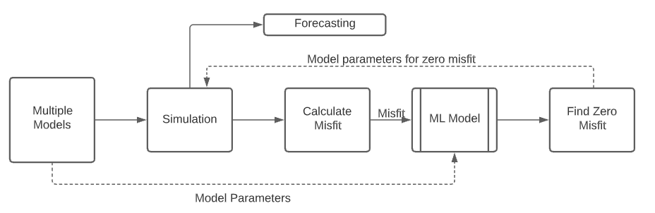
Introduction – Problem Description
Figure 1: Problem Description

Slide 4
Introduction - The Data Set
A dataset of 200,710 reservoir models collected by BP.
Data set contains 35 binary and continuous variables including:
Cumulative Production,
Facies Porosity,
Facies Permeability,
Flow Channel,
Net-to Gross ratio,
Fault Transmissibility,
Conductivity,
Gas Residual Saturation,
Oil Residual Saturation
Total misfit between actual production and model predicted production (mq)
Misfit between model predicted oil produciton and observed production (mq.FIELD.FIELD.QOP).

Slide 5
Introduction – Scope of Project
The scope of the project is as follows:
To build a regression model which uses columns input production and reservoir parameters to predict the Total misfit between actual production and model predicted production (mq)
To build a regression model which uses columns input production and reservoir parameters to predict the misfit between model predicted oil produciton and observed oil production (mq.FIELD.FIELD.QOP).
Use model 1 to determine what input is needed to get ‘mq’ to be zero.
Use model 2 to determine what input is needed to get ‘mq.field.field.QOP’ to be zero.

Slide 6
Description of Workflow
Data Visualization
Matrix scatter plot
Data preprocessing
No outliers
Using Random forest variable importance feature to reduce the number of variables and select only the important ones for the regression
Only input data was scaled

Slide 7
Description of Workflow
Supervised learning
Regression Problem:
Model 1 uses ‘CWP’, ‘CWI’, ‘COP’, ‘CGP’, ‘COW.1’ and ’CW.1’ as Input variables to predict ‘mq’
Model 2 uses ‘CWP’, ‘COP’, and ‘PERM.1’ as Input variables to predict ‘mq.FIELD.FIELD.QOP’
Algorithms Used:
Random forest with random hyperparameters
Random forest regression with hyperparameter tuning
K-Nearest Neighbors regression
Support Vector Machine for regression
Prediction of input data that will provide zero(0) ‘mq’ and ‘mq.FIELD.FIELD.QOP’
Reverse fit model on test data and predicting outcome
Use of inverse scaler.
Comparison of outcome using fewer features to outcome using all features.

Slide 8
Data Pre-Processing
No outliers in data set
Scaling
The min-max scaler was used for the entire project.
Binary data was left unscaled because they are either 0 or 1 and using min max scaler will give the exact same results.

Slide 9
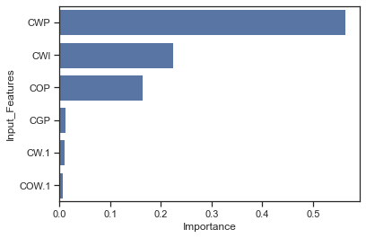
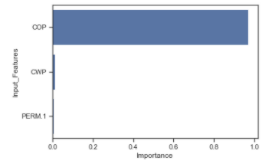
Data Pre-Processing
Dimensionality reduction
Used random forest’s variable importance feature to show what variables contribute the most to the regression of the data set.
Found that CWP, CWI, COP, CGP, COW.1 and CW.1 offered the most contribution to the regression for ‘mq’.
COP, CWP and PERM.1 contributed most to the regression for ‘mq.FIELD.FIELD.QOP’.
Carried this out for the two outputs to be predicted (‘mq’ and ‘mq.FIELD.FIELD.QOP’).
Figure 2: Feature Importance for mq
Figure 3: Feature Importance for mq.FIELD.FIELD.QOP

Slide 10
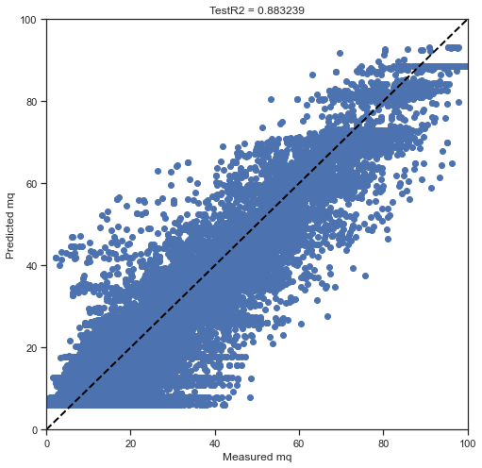
Supervised Learning – Regression for ‘mq’.
Random Forest with randomly selected hyperparameters
Train/Test split = 0.3

Slide 11
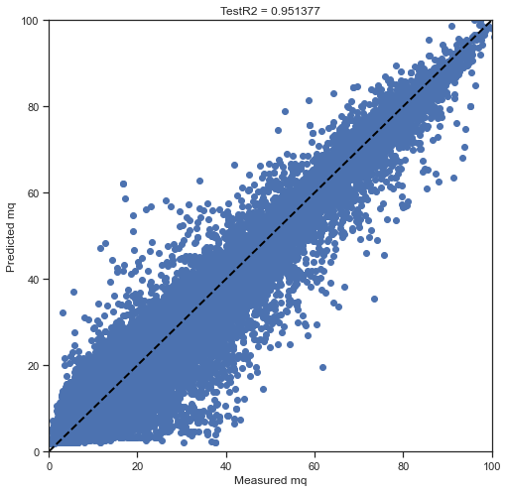
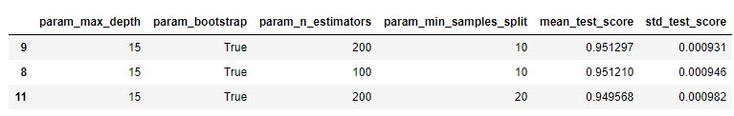
Supervised Learning – Regression for ‘mq’.
Random Forest with hyperparameter tuning using ‘GridSearch_CV’
Train/Test split = 0.3
Variable | Value at misfit = 0 | Unit
CWP | 145,421 | bbl
CWI | 259,637 | bbl
COP | 134,000 | bbl
CGP | 71,096 | scf
COW.1 | 2 | %
CW.1 | 3 | %

Slide 12
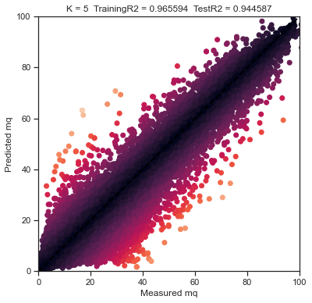
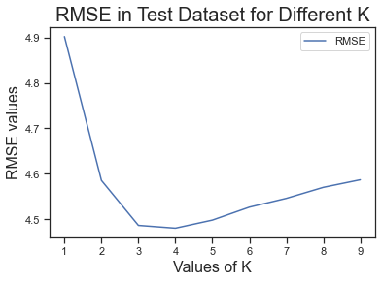
Supervised Learning – Regression for ‘mq’.
K- Nearest Neighbors
Train/Test split = 0.3
Number of Neighbors = 4

Slide 13
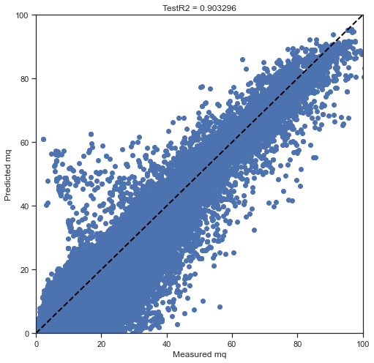
Supervised Learning – Regression for ‘mq’.
Support Vector Regression
Train/Test split = 0.3
Hyperparameter tuning
C = 1
Gamma = 10

Slide 14
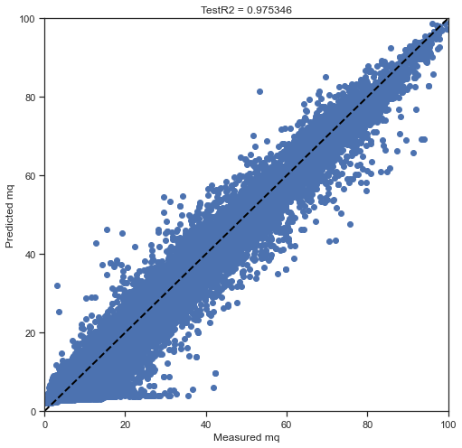
Supervised Learning – Regression for ‘mq’.
Random forest using all variables and tuned hyperparameters (for comparison)

Slide 15
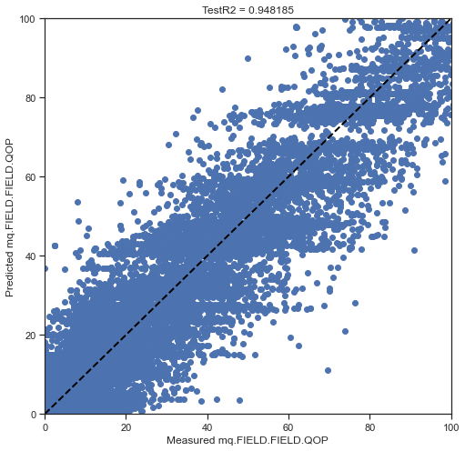
Supervised Learning – Regression for ‘mq.FIELD.FIELD.QOP’.
Random Forest with randomly selected hyperparameters
Train/Test split = 0.3

Slide 16
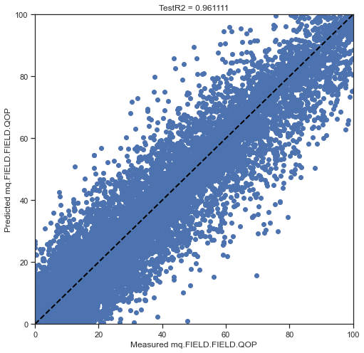
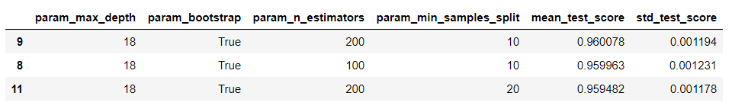
Supervised Learning – Regression for ‘mq.FIELD.FIELD.QOP’.
Random Forest with hyperparameter tuning using ‘GridSearchCV’
Train/Test split = 0.3
Variable | Value at misfit = 0 | Unit
CWP | 112,280 | bbl
COP | 146,493 | bbl
PERM.1 | 1,657 | mD

Slide 17
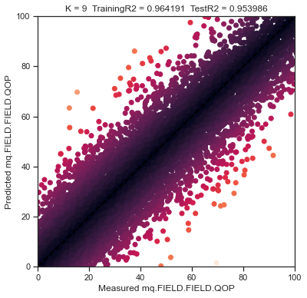
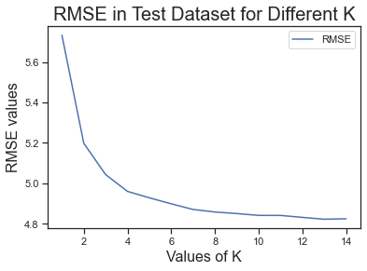
Supervised Learning – Regression for ‘mq.FIELD.FIELD.QOP’.
K- Nearest Neighbors
Train/Test split = 0.3
Number of Neighbors = 9

Slide 18
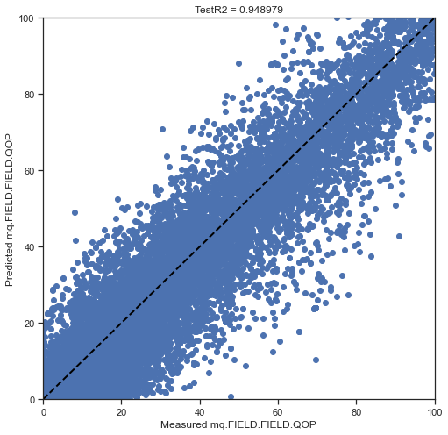
Supervised Learning – Regression for ‘mq.FIELD.FIELD.QOP’.
Support Vector Regression
Train/Test split = 0.3
Hyperparameter tuning
C = 10
Gamma = 10

Slide 19
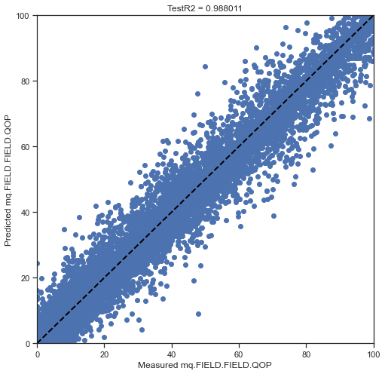
Supervised Learning – Regression for ‘mq.FIELD.FIELD.QOP’.
Random forest using all variables and tuned hyperparameters (for comparison)

Slide 20
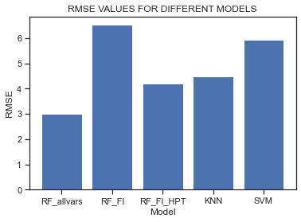
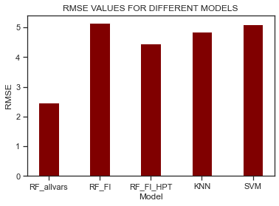
Supervised Learning
RMSE Errors for mq models
RMSE for mq.FIELD.FIELD.QOP models
RF_allvars RF with all variables
RF_FI RF with chosen variables after feature importance
RF_FI_HPT RF with chosen variables and hyperparameter tuning
KNN K-Nearest Neighbour
SVM Support Vector Machine

Slide 21
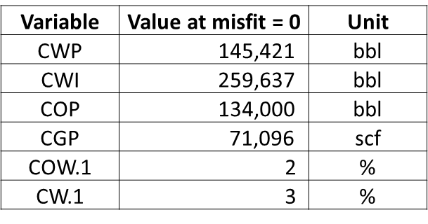
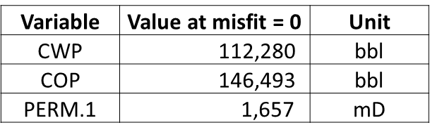
Conclusions
For an accurate forecast of total field production, simulation model parameters around the values in table below would help. This was obtained by fitting the random forest with HP tuning such that the output/input roles are reversed. The inverse scaler fature was then used to obtain unscaled data.
For an accurate forecast of total field oil production, use the following parameters:

Slide 22
Conclusions
Random forest and K-Nearest neighbor are two very good regression models for predicting model misfit.
Random forest variable importance feature was able to find the most important variables for the regression problems.
Random forest with hyperparameter tuning gives the most accurate model for this prediction in terms of the RMSE metric.

